Slide 1
COVID-19 Peak Prediction using Logistic Function

Slide 2
Outline
Introduction
Project Background
Motivation and Problem Statement
Datasets
Methodology
Results
Division of Work

Slide 3
Introduction
Corona Virus disease 2019(Covid-19) is an highly infectious and transmitted that was first discovered in Wuhan City, China around December 2019.
But in India, it was reported first in Kerala State on January 2020.
Our main aim is to get the estimation for the total number of cases recovered and deaths around the globe using technology.

Slide 4
In our python project, we will implement a live dashboard for Covid – 19 spread analysis.
The dashboard will give numerous insightful visualization to the investigation of covid spread.
We will be using NumPy, Matplotlib, SciPy and Pandas as our libraries to perform analysis and visualization of this project.
In this undertaking, we will deal with datasets of top 15 countries and we will create a dashboard.

Slide 5
Project Background
In this Project, we will be imposing some real time datasets that we needed for analysis.
We take some cumulative number of confirmed cases and deaths that has been published and check for the relationship between the spread of the virus.

Slide 6
Coronavirus disease 2019 (COVID – 19 ) is a contagious disease caused by severe acute respiratory syndrome coronavirus 2 (SARS – CoV-2).
In recent years, Covid – 19 pandemic has affected many countries around the world economically.
It is declared as a pandemic by World Health Organization (WHO).

Slide 7
This project involves in performing data modelling, analyzing and the result will be the prediction.
Here mainly we will be using Python 3, Pandas and mainly Matplotlib.
Python 3: We are using Python 3 as it is latest version and it includes more libraries.
Python 3 performance is faster compared to other techniques.

Slide 8
Model Choosing is the task as we need to add some logistics functions and also some sigmoid functions and also the curve starts and eventually it could also maintain the growth of the curve as an exponential calculations.
Normalizing the variables such as x and y by assigning them as 0 and 1, then it will be done as in a equal preference.
The model evaluation is for training and testing for the statistical data resulting of the regression.

Slide 9
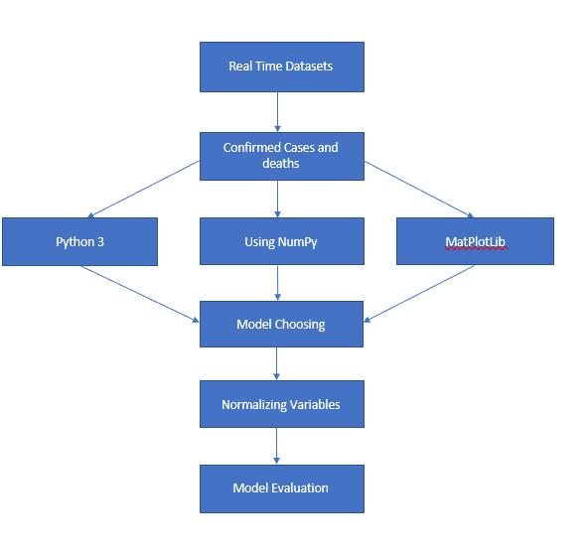
Flow Chart Diagram

Slide 10
Motivation & Problem Statement
There are many sources of getting the covid – 19 affected areas data, but most of them deals in a complex manner.
Covid-19 has spread all over the world and to check , analyze the number of cases, death rates etc., we have to go through long spreadsheets and excel sheets it will be very exhausting and consumes a lot of time so there should be easy way to analyze and visualize the figures in order to solve this pandemic.

Slide 11
This model allows better priority to certain people who are affected by the virus.
Right now, we have designed the project for One Disease, but it can be designed for more diseases.
It acts as a life-saving device. -All the tools and technologies used for developing COVID-19 detector are free hence the cost of production and development is close to NULL.

Slide 12
All COVID-19 detector required is an internet connection which makes it affordable for everyone.
To look easy and simply to understand
There are many sources of getting the covid related information
Most of them are hard to understand

Slide 13
Summarizing Motivation of The Project
To look easy and simple to understand
There are many sources of getting the covid related information
Most of them are really hard to understand

Slide 14
This problem motivated us to make this as our project
Collecting the data of all the covid information.
Gathering datasets with required data
Implementing using the python Statistics

Slide 15
Benefits of The Solution
All the covid related information in a single live chart
Looks clear and understandable
Visualizing all the countries and the effects of covid – 19
Measuring the impact of the Covid – 19 Affected countries and regions

Slide 16
Data Sets
This data set will basically include the daily analysis of covid-19 which gives the geographically distributed data.
To ensure the reliability of the data, this process is being distributed equally and this helps to refine the data constantly.
This helps to monitor and interpret the statistics around the data. An extract of this database will result in the maximum level of transparency.

Slide 17
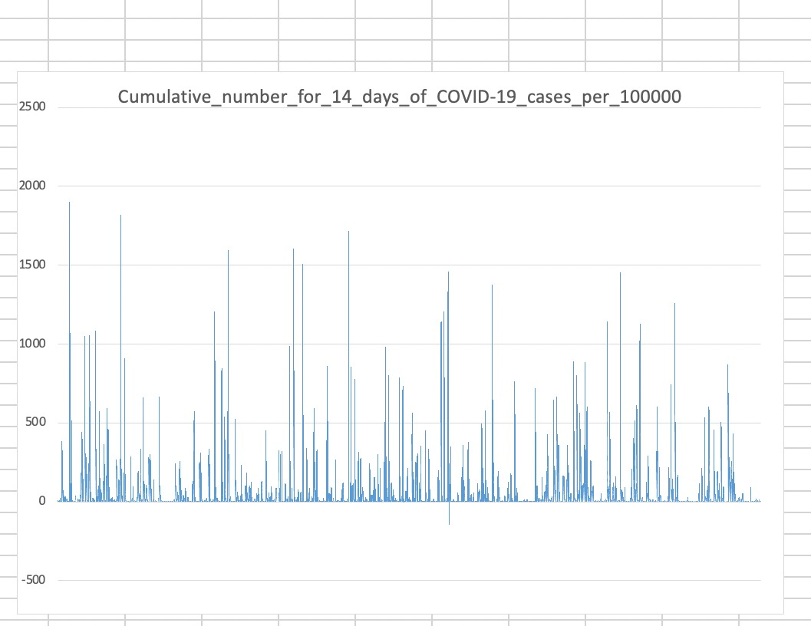

Slide 18
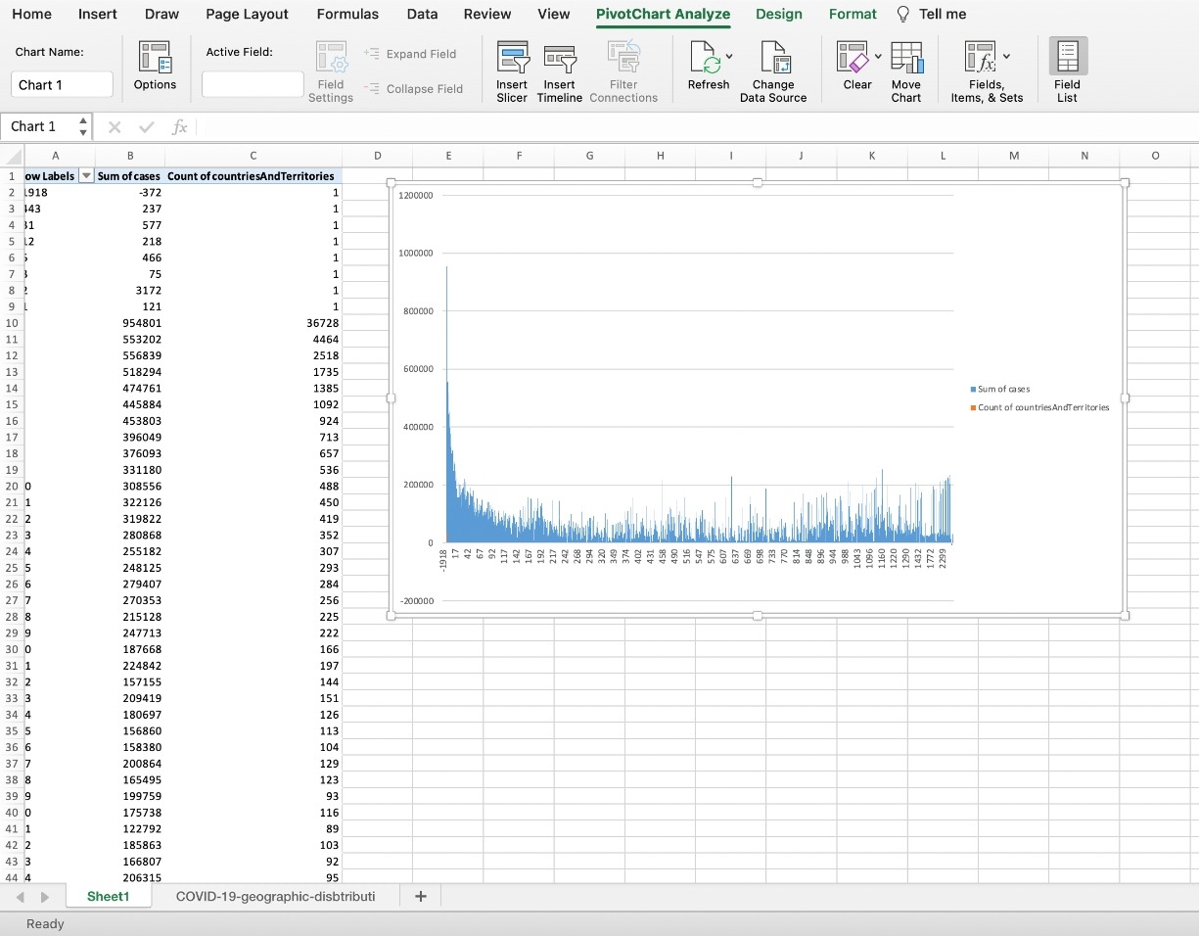

Slide 19
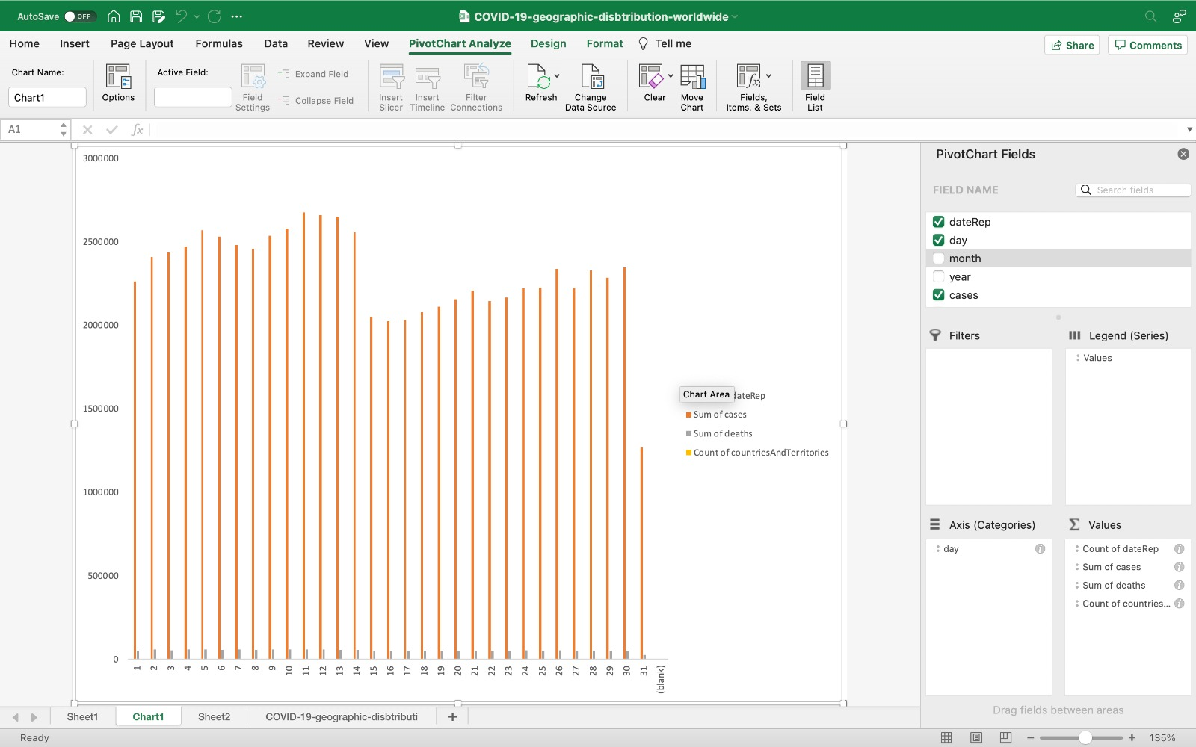

Slide 20
Methodology
NumPy – NumPy is a Python library which is very famous as it usually working for arrays, and it is also called Numerical Python. The command used for it to install is
import NumPy as np
SciPy - SciPy stands for Scientific Python. Like NumPy, SciPy is open source so we can use it freely. SciPy was created by NumPy's creator Travis Oliphant.

Slide 21
Random – The Random module is a built-in module to generate the pseudo- random variables. It can be used perform some action randomly such as to get a random number, selecting a random elements from a list, shuffle elements randomly.
Pandas – Pandas is a Python library, and it is also used to analyse the data. It is also used for correlation and plotting of the data. Insert the correct method to create the series by
pd. (my list)

Slide 22
Matplotlib – Matplotlib is an amazing visualization in python library used to create arrays for 2D and 3D. It is a multi platform data visualization library.
Non – linear regression – It is a mathematical model that will be in a fit equation, it uses a straight-line equation such as y = c + mx. It uses as a curve which makes it a nonlinear.

Slide 23
To accomplish this objective, Non-linear regression has been applied to the model, using a logistic function.
This process consists of:
Data Cleaning
Choosing the most suitable equation which can be graphically adapted to the data, in this case, Logistic Function (Sigmoid)
The formula for the logistic function is:
Y = 1/(1+e^B1(X-B2))
Database Normalization

Slide 24
Fitting of the model to our dataset using “curve_fit” process, obtaining new reference beta.

Slide 25
Results
Based on the data sets that we have taken above, the data will be merged into the python tool (Jupiter Notebook) by first importing the libraries and then by adding the files to it.

Slide 26
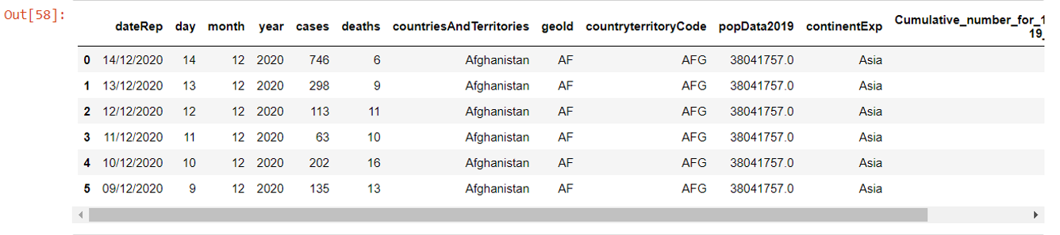
Reading Data From The Table

Slide 27
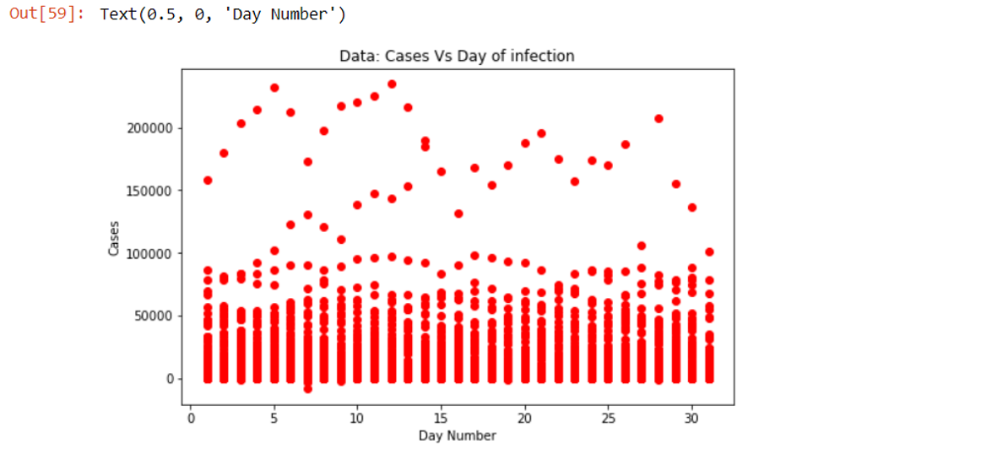
Graphical Representation of Cases Vs Day of Infection

Slide 28
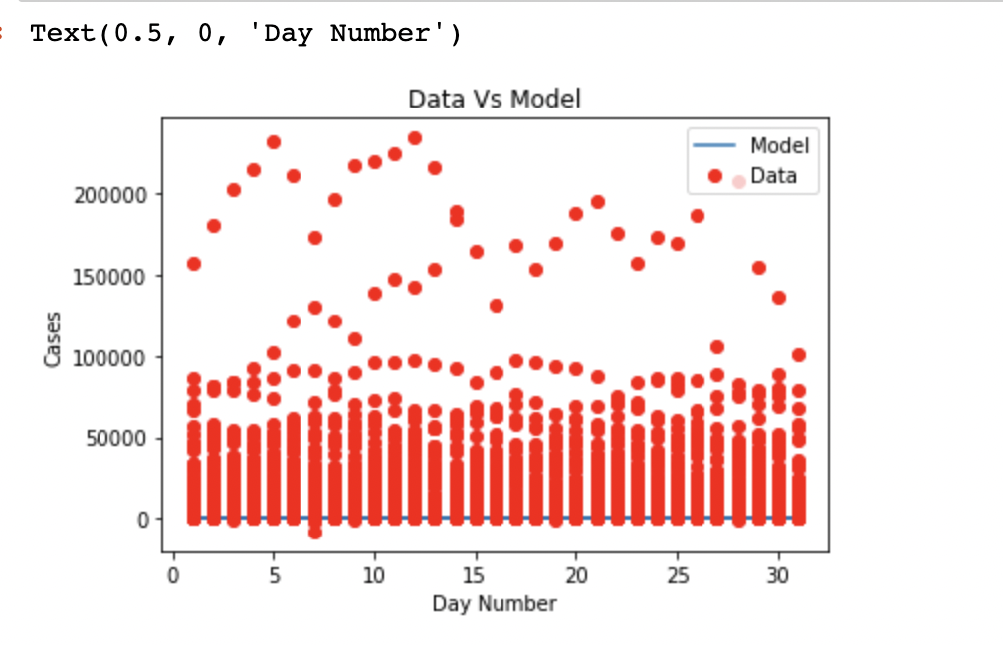
Data Vs Model Graph

Slide 29
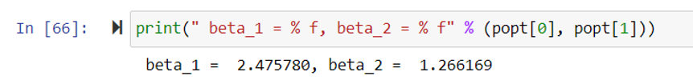
Printing the Final Parameters Using Curve fit Formula which uses Non-Linear Regression

Slide 30
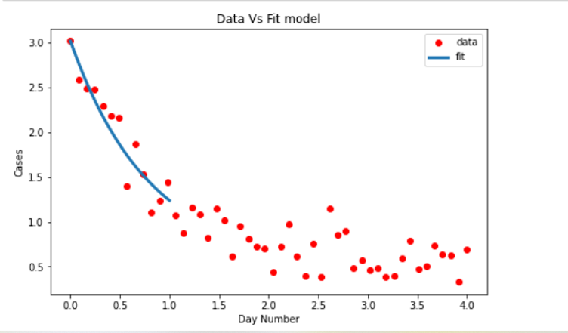
Graphical Representation of Final Data Vs Fit Model after Apply New beta Value

Slide 31
Division Of Work
Ashok Dobbala ~ Gathering Data, Research Coding, Presentation
Megha Shah ~ Coding , QA, Presentation
Ananthaneni Vamsi Krishna ~ Working on Data, Coding, Presentation
Manisha konjeti ~ Doumentation, QA, Presentation

Slide 32
Thank you

